Slide 1
Object and its effects eliminate
數據所 310554031 葉詠富
數據所 310554037 黃乾哲
Notes:
Hello everyone!
we are group 14, my name is 黃乾哲. and My name is 葉詠富.

Slide 2
Outline
Introduction
Workflow
Preprocessing
method
Mask R-CNN
RAFT
Combine Mask
Deepfillv2
Improve & Compare

Slide 3
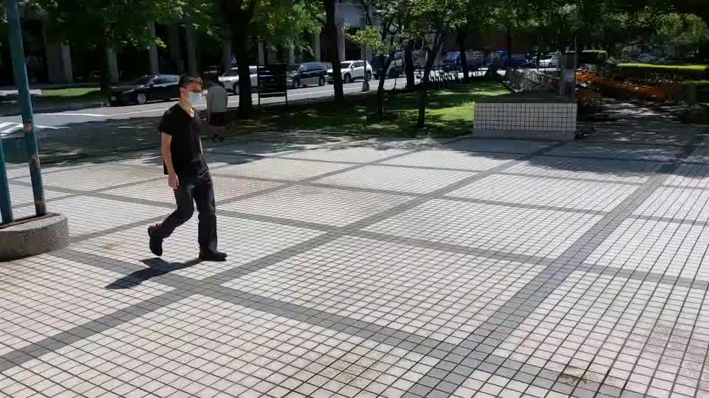
Our Goal
Goal: Eliminate the people and its shadow in
the video.
the video is shoot with small angle of vision movement.
To eliminate the object shadow, we will convert video to images.
original video
Notes:
Our target is to eliminate the people and its shadow in the video.
the video needs to be shoot with a static camera.
And we will convert the video to image.

Slide 4
Workflow
Mask RCNN
video
Combine mask
Inpaint image
image
RAFT
Notes:
this is our workflow.
First, we will use the mask RCNN to select only the people and use the RAFT to select both the people and its shadow.
Second, we will combine the Mask from mask R-CNN and RAFT to produce a better mask.
Finally, we remove the object with the mask and inpainting the disappearing part in the image.

Slide 5
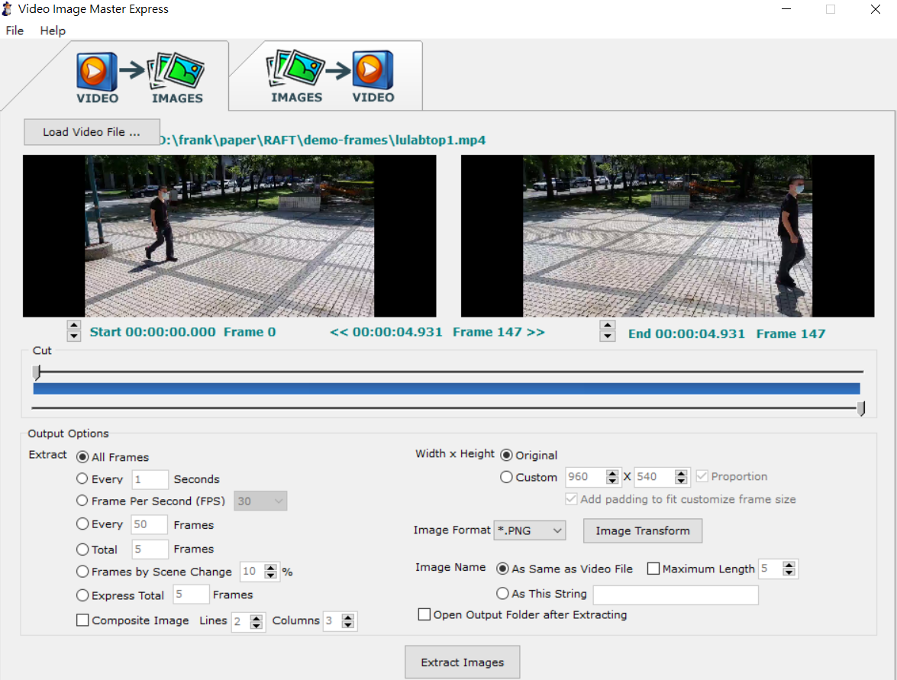
Preprocessing
We Use the tools “Video Image Master Express” convert video to images.
Notes:
we Use the tools “Video Image Master Express” convert video to images.
The Frame is set to _幾幀_ per second

Slide 6
Mask R-CNN

Slide 7
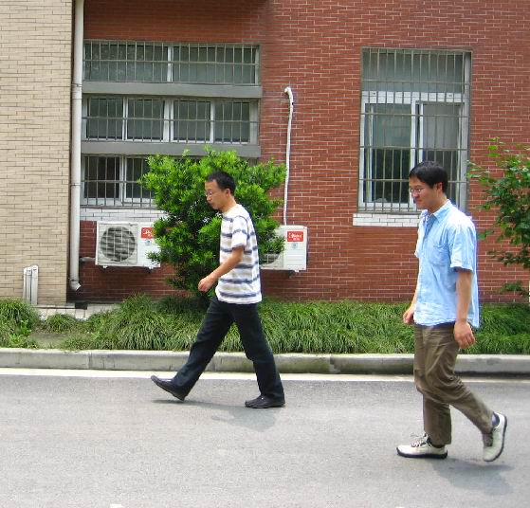
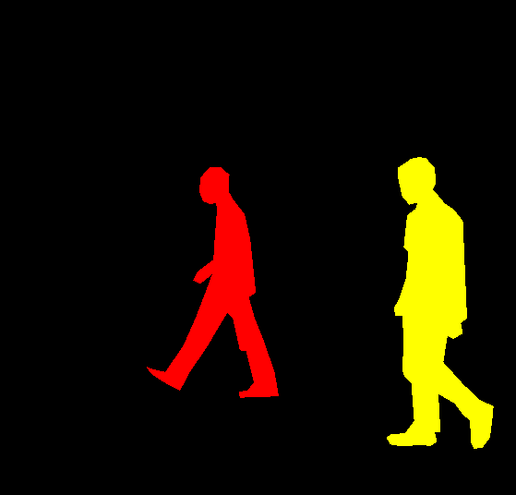
Mask R-CNN
We use the Mask RCNN to select the object.
The training data is “PennFudanPed” which is containing images that are used for pedestrian detection in the experiments reported.
Notes:
We use the Mask RCNN to select the people.
the Mask RCNN is use the PennFudanPed as our dataset. And it includes several pedestrian images and mask
.

Slide 8
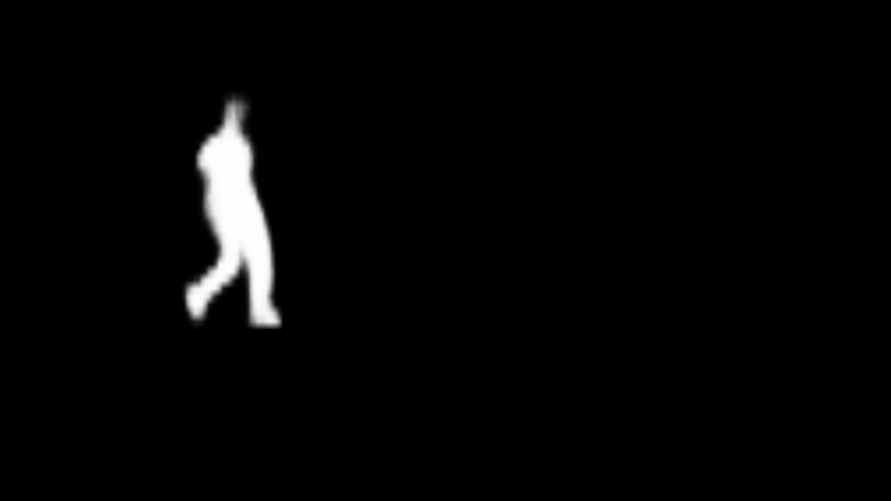
Since our background is simple, the human contour is clear.
We do the threshold to strengthen the curve of the mask.
Result
Notes:
Since the video background is clear so the final result can select the people easiliy.
We use the result to do the threshold, if pixel is not including in the object segment, we set black. Otherwise, we set white

Slide 9
RAFT

Slide 10
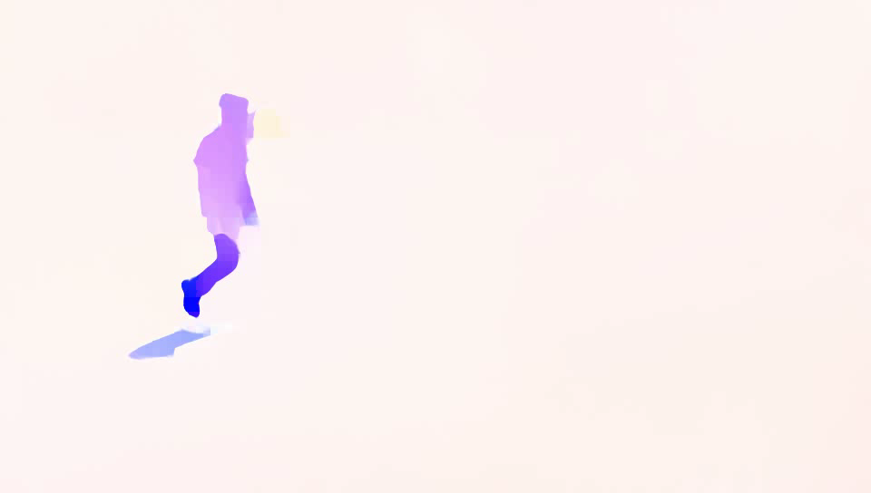
Flow to RGB
Use the pretrain model raft-thing to detect the flow from people and shadow
convert flow to rgb images
Notes:
we Use pretrain model raft-thing to detect the flow from people and shadow
convert flow to rgb images
you can see the below video

Slide 11
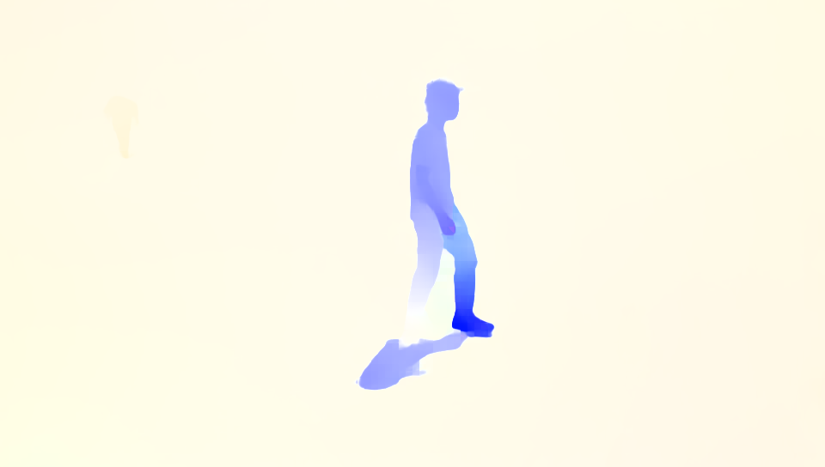
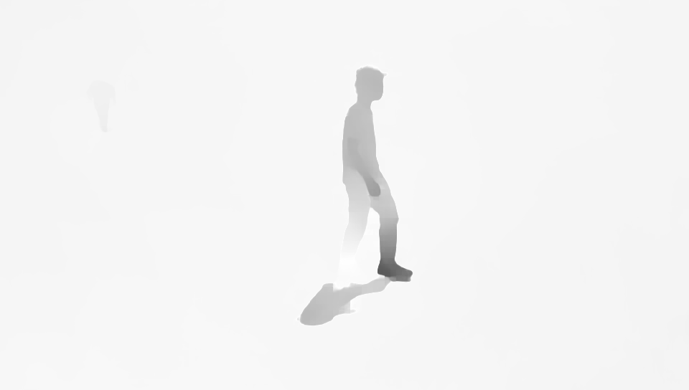
RGB to Gray
convert rgb image to grayscale image
Notes:
and next we convert rgb image to gray scale image

Slide 12
RAFT Mask
Mapping grayscale images onto a 1D vector
Set the threshold to create RAFT Mask.
The threshold is set with percentiles.
For example: 10% of the data is less than the threshold as the foreground, greater than the threshold as the background
255
background
10%
threshold
foreground
0
Notes:
Next, we set the threshold to make RAFT_mask
The threshold is set with percentiles
For example 10% of the data is less than the threshold as the foreground, greater than the threshold as the background
As the following picture, most of them are brighter, so the background is the part larger than the threshold, and the foreground is smaller than the threshold.

Slide 13
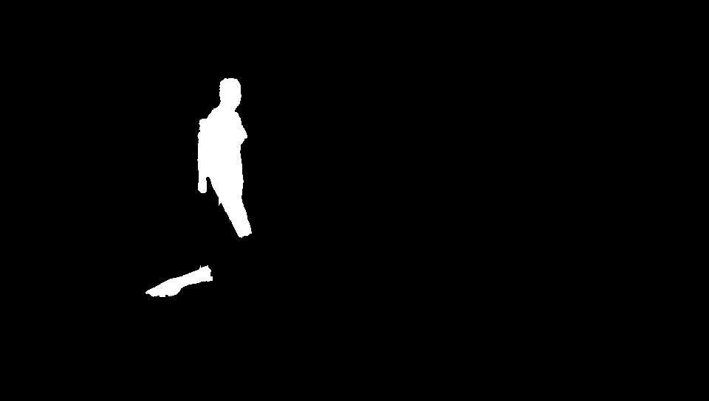
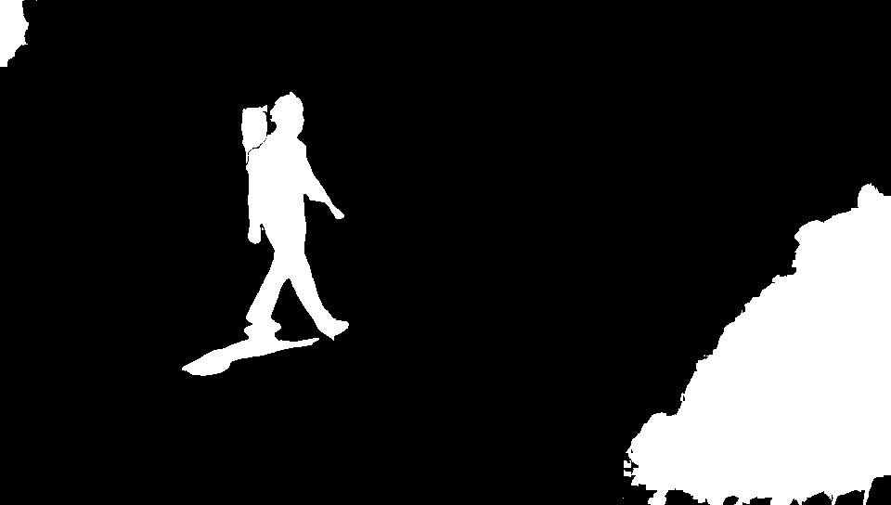
RAFT Mask
threshold 2% vs 10%
2% covers less shadows, but reduces the effect of optical flow in nearby scenes
10% covers more shadows, but increases the effect of the optical flow of nearby scenes
We choose 10%, hoping to cover more shadows
2%
10%
Notes:
threshold 2% vs 10% you can find the below two pictures
2% covers fewer shadows, but reduces the effect of optical flow in nearby scenes however
10% covers more shadows but increases the effect of the optical flow of nearby scenes
We choose the threshold 10% because we hoping to cover more shadows

Slide 14
Combine Mask

Slide 15
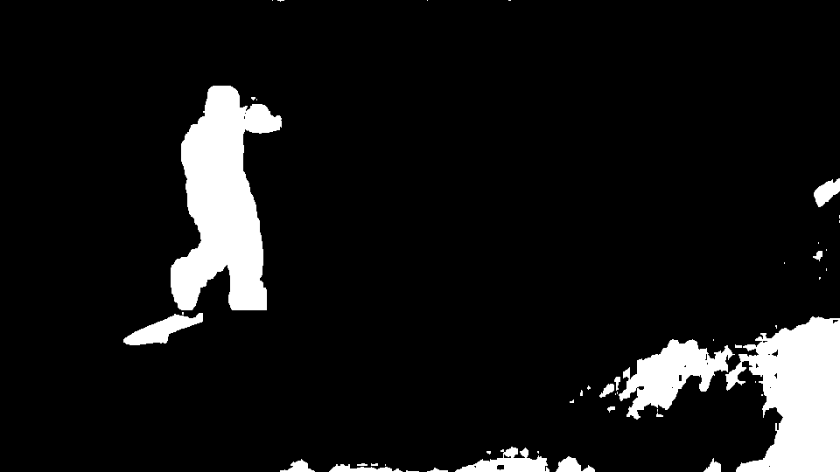
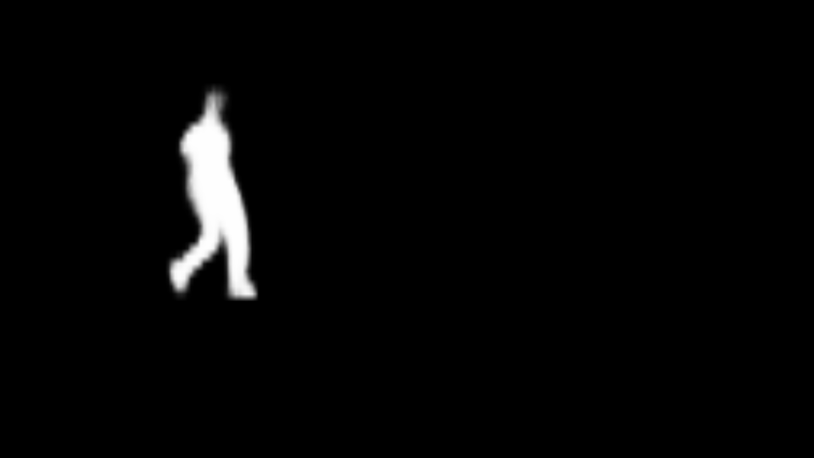
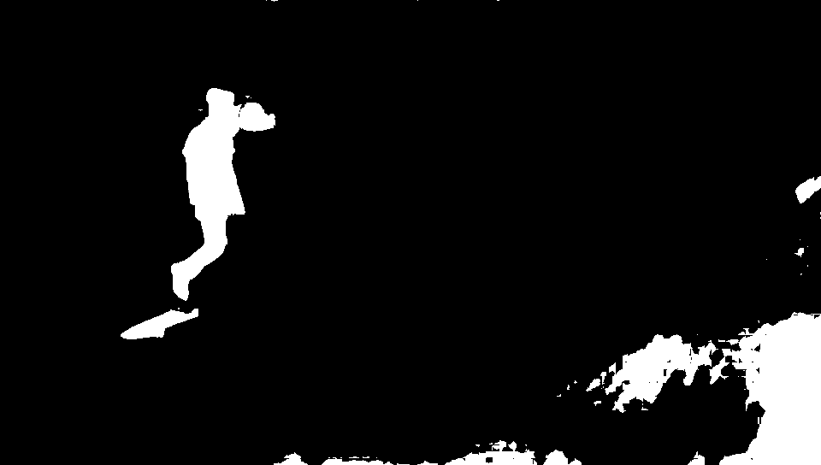
Mask R-CNN + RAFT
Mask RCNN is good at detecting the object.
RAFT is good at detecting the shadow.
Combine the both advantage to produce the mask.
Notes:
Mask RCNN can detect the object but can not detect the shadow.
RAFT can detect the shadow but is hard to detect the object. If the optical flow of the object is too similar, the RAFT cannot detect it.
we combine both advantages to produce the mask, Use the result of Mask RCNN to cover the whole part of the object.
the combined method is if the pixel in one of the masks is white, the pixel in the final mask will be white.
因為當物體的顏色過於相近時，RAFT所產生的Mask並沒有辦法很清楚的辨識出來，所以會需要加上Mask RCNN產生的Mask來協助還蓋出整個物體

Slide 16


Mask preprocess
Since the Mask-RCNN and RAFT will loss some small noise, it will effect the image inpainting result. we use close operate to eliminate them.
Close
Notes:
after the combine both masks, there are some small parts does not be detected.
We use the close operation to eliminate them.
One of the advantages is close operation can make the mask bigger, and it can cover the whole part of an object and it shadow

Slide 17
Deepfillv2

Slide 18
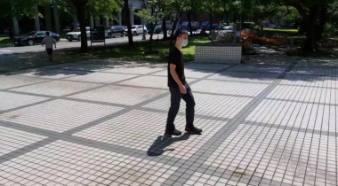
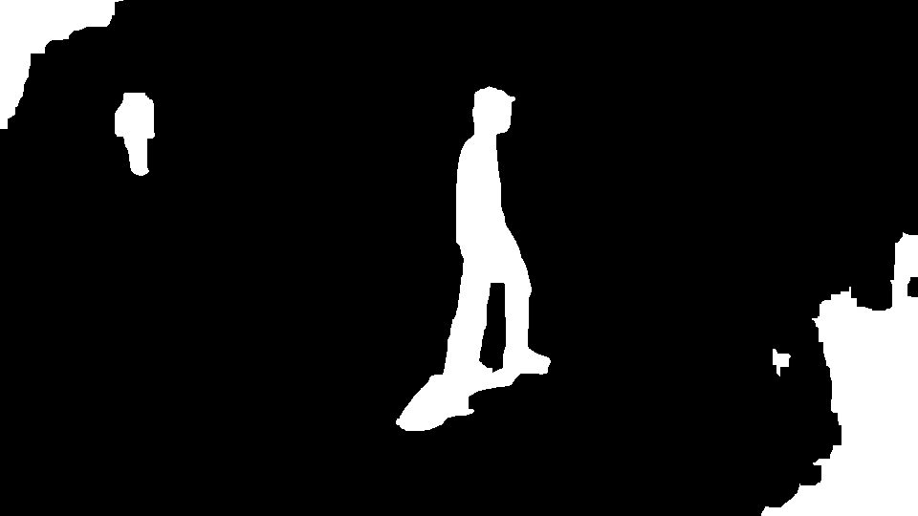
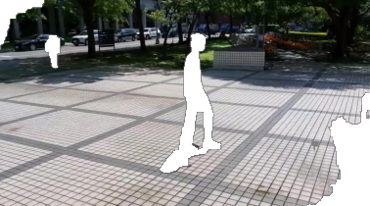
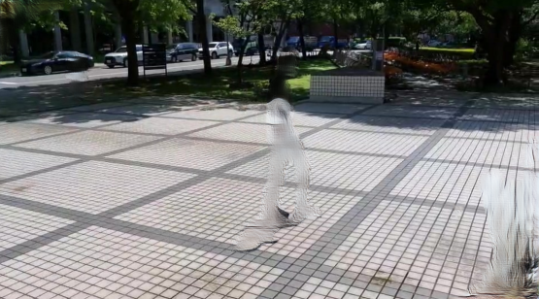
Deepfillv2
We use pre-train model Deepfillv2 to inpainting disappear part by the mask
a.
b.
c.
d.
Notes:
We use pre-train model Deepfillv2 to inpainting disappear part by the mask
picture a is the original image.
Picture b is the final mask combined by mask rcnn& raft mask.
picture c is disappear part by the mask
picture d is the final result by deepfillv2

Slide 19
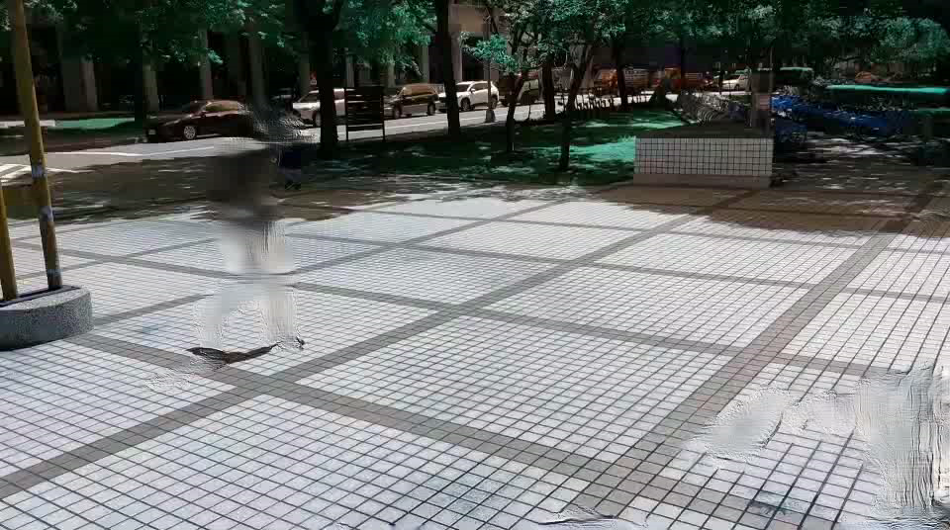
Result
original
our result
Notes:
The left video is the original video
The video on the right is with people and shadows eliminate

Slide 20
Improve & compare

Slide 21
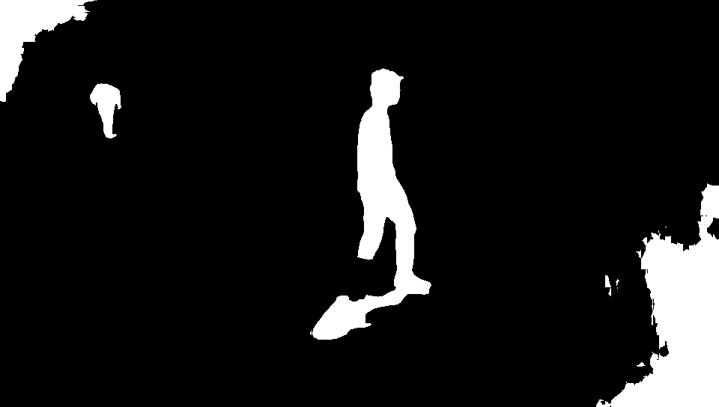
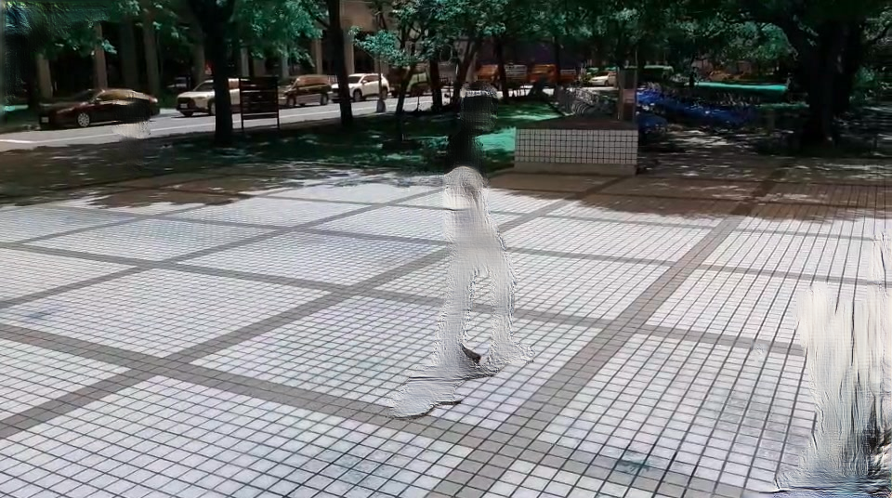
Our purpose
People we don't want to eliminate are eliminated.
In order to cover more shadow information, the background is also eliminated.
Notes:
Our purpose.
First, you can see the below picture the red circle that People we don't want to eliminate are eliminated
second To cover more shadow information, we use the 10% threshold, so you can see the green circle in the background is also eliminated

Slide 22
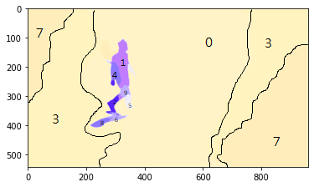
RAFT Mask by KMeans
group id | n
5 | 605 | foreground
6 | 714 | foreground
8 | 754 | foreground
2 | 879 | foreground
9 | 1288 | foreground
4 | 2822 | foreground
1 | 4247 | foreground
0 | 90505 | background
3 | 199233 | background
7 | 221093 | background
Divide the rgb optical flow map into 10 groups using Kmeans
Sort by the number of pixels in the group
If the difference between the front and the back is 5 times, it is the dividing point between the foreground and background.
Example: 90505/4247=21 > 5
dividing point
Notes:
so We improve the RAFT mask by kmeans
first Divide the RGB flow map into 10 groups using Kmeans
next Sort by the number of pixels in the group
next If the difference between the front and the back is 5 times(中文解釋),
可以看到右邊這張表，我依照每個群裡面的pixel數量做排序，然後找出前後數量差很多的地方當作分界點，在分界點上的是前景 下的是背景
Example: 90505 division 4247 is 21 bigger than five

Slide 23
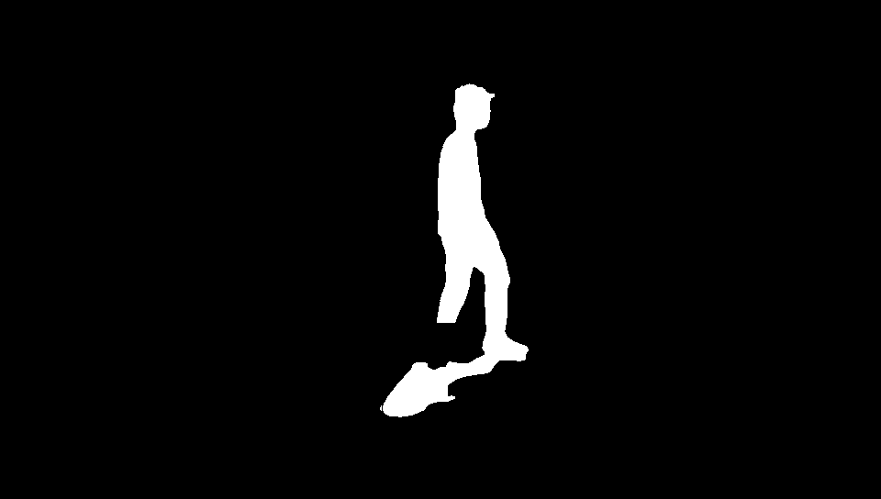
RAFT Mask by KMeans(cont.)
We can find that the use of kmeans can better connect the relationship between people and shadows to generate masks
Eliminate the effects of background
The people behind it were also used as the background
threshold
Kmeans
Notes:
We can find that the use of kmeans can better connect the relationship between people and shadows to generate masks
and you can see the green circle, Eliminate the effects of the background
And the people behind is not Eliminate

Slide 24

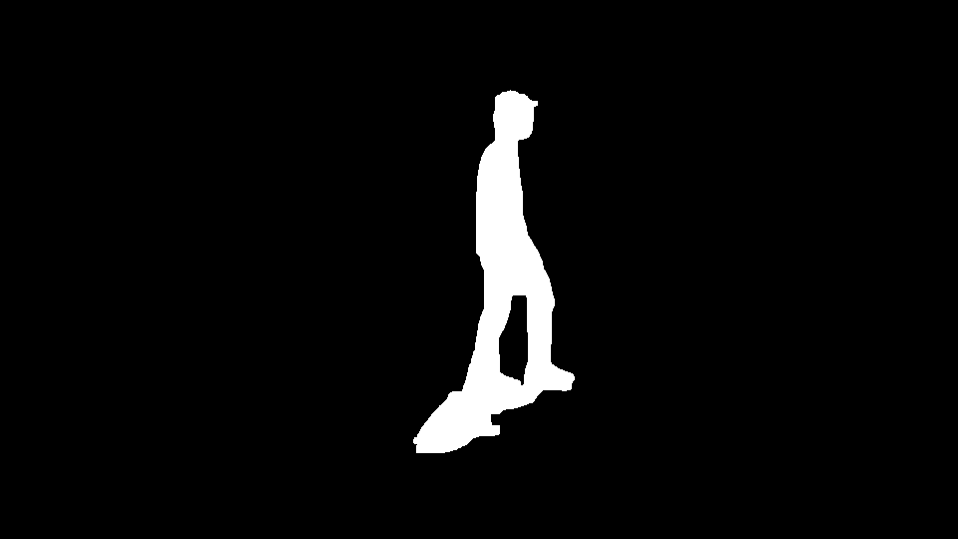
Combine Mask
combine mask from Mask R-CNN & RAFT(KMeans)
Mask R-CNN
RAFT(KMeans)
Notes:
and next we also combine mask from Mask R-CNN & RAFT(KMeans)

Slide 25
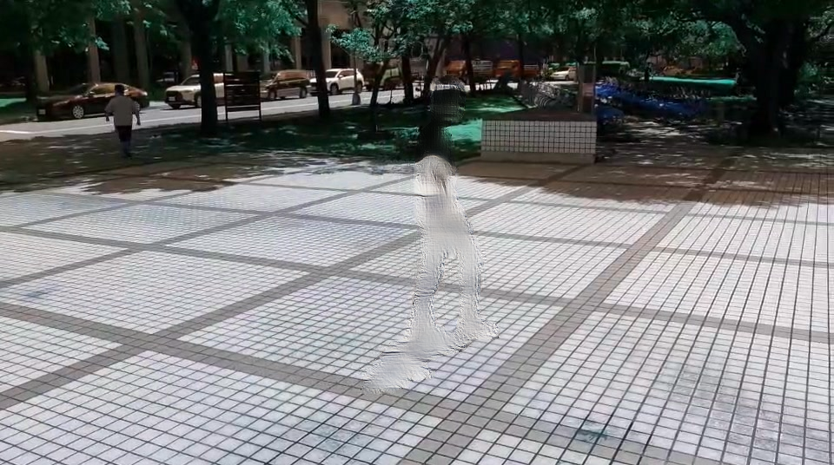
Compare result
use Deepfillv2 to inpainting the disappear part by mask
And the people behind the original were kept
mask r-cnn + raft(threshold)
mask r-cnn + raft(KMeans)
Notes:
We also use Deepfillv2 to inpating the disappear part by mask
And you can find the people behind the original were kept
and background is not Eliminate

Slide 26
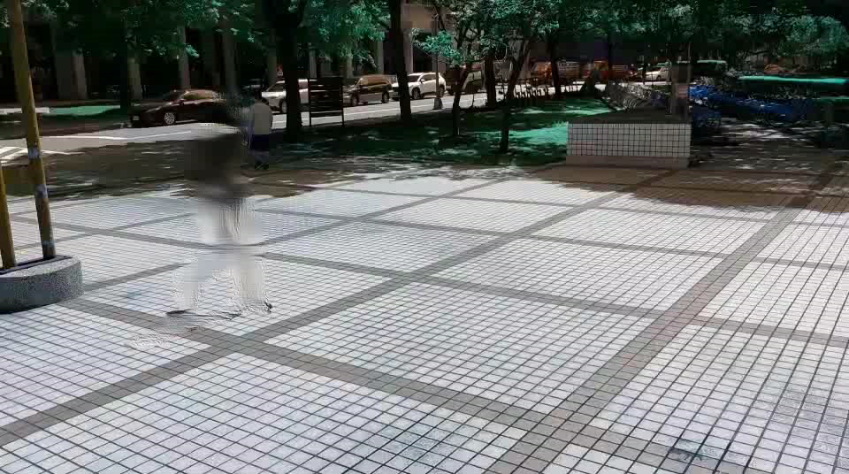
Compare result
mask r-cnn + raft(threshold)
mask r-cnn + raft(KMeans)
Notes:
The left video is the mask r-CNN & raft(threshold)
The right video is the mask r-CNN & raft(kmeans)

Slide 27
Discussion
The mask almost covers the whole object and its effect.
RAFT can not detect the whole shadow, it may cause by the action of the object.
Inpainting result is not natural, it needs to retrain a personal model for this video’s background.

Slide 28
Thank you for listening

Slide 29
Refrence
Mask R-CNN
https://www.youtube.com/watch?v=5VLI_gbpocE&t=1s&ab_channel=WilsonHo
https://zhuanlan.zhihu.com/p/142757151
https://pytorch.org/tutorials/intermediate/torchvision_tutorial.html
RAFT
https://github.com/princeton-vl/RAFT
https://arxiv.org/pdf/2003.12039.pdf
Deepfillv2
https://github.com/nipponjo/deepfillv2-pytorch
KMeans
https://www.thepythoncode.com/article/kmeans-for-image-segmentation-opencv-python
https://www.geeksforgeeks.org/image-segmentation-using-k-means-clustering/
https://docs.opencv.org/4.x/d1/d5c/tutorial_py_kmeans_opencv.html

